Slide 1

INVESTMENT PREFERENCES ACROSS AVENUES
INTERNSHIP PROGRAM (EXCEL) TASK 2
AN ANALYSIS OF EMPLOYEE INVESTMENT CHOICES
PRESENTED BY: ADEYEMI ADENUGA

Slide 2

Analysis Approach
Introduction
Objectives
Dashboard Features
Insights
Recommendations

Slide 3

Introduction
“Investment avenues are needed to boost engagements and participation in an organization”

Slide 4
Objectives
Analyze investment preferences across different avenues
Understand the distribution, duration and reason behind these choices
Provide actionable recommendations for improvement

Slide 5

Dashboard Features
Slicers for Investment Avenues
Link for Pivot table report, detailed analysis sheets and Visualization dashboard.

Slide 6
KPIs
Male Investors: 25 (62.5%)
Female Investors: 25 (37.5%)

Slide 7
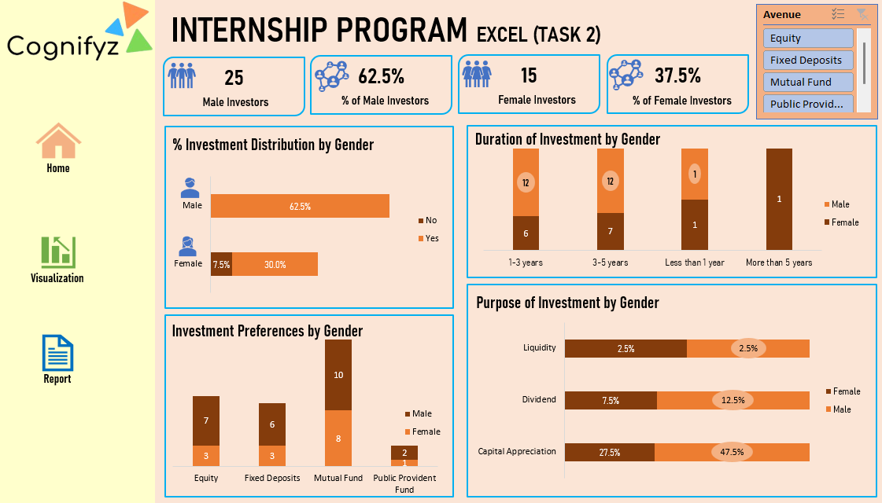

Slide 8
Insights
Observations: Male employees shows a strong preferences for risk in investment than the female

Slide 9
Conclusion
Short-term investments are popular but males prefer equity, while female prioritizes liquidty.

Slide 10
Recommendations
Create gender focused investment plans to address their personal goals
Introduce avenues that appeal to both genders
Provide tools and resources to help employees align with their investment options

Slide 11
Thank you
Adeyemi Adenuga
+2348092373334
pearlxtamet@outlook.com

